Slide 1
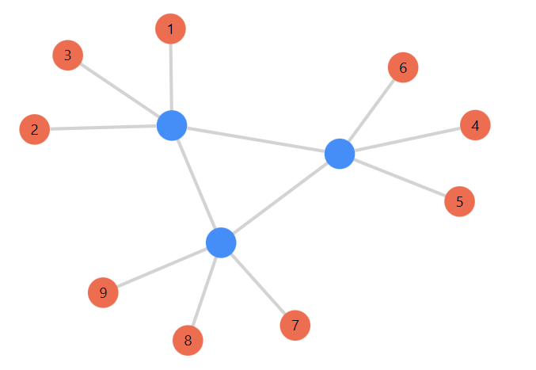
Tensor-network codes
Final Project
E2-210: Quantum Error-Correcting Codes
Manish Kumar (21044)
Oza Harshkumar Ajaykumar (20929)
M.Tech. in Quantum Technology

Slide 2
Outline
Tensor Network Notation (TNN)
Tensor Operations
Tensor Networks
Stabilizer codes as tensors
Generating new stabilizer codes
Code distance via tensor network
Maximum Likelihood decoding (MLD) via tensor network

Slide 3




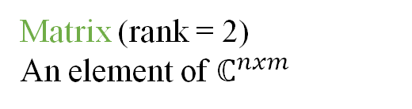





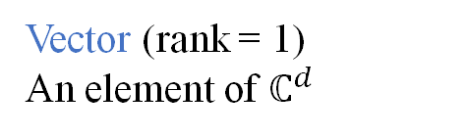















Introduction to Tensor Network Notation (TNN)
Tensors?
Generalisation of vectors and matrices
Dimension (d): Number of values an index can take
Rank (r) = Number of indices = Number of legs
Einstein Notation
TNN
Vector (rank = 1)
An element of $ℂ^{d}$
$$v=\left[\begin{aligned}1 \\ 2\end{aligned}\right]$$
$$v_{i}$$
$$v$$
$$i$$
Matrix (rank = 2)
An element of $ℂ^{nxm}$
$$M=\left[\begin{matrix}2 & 4 \\ 1 & 3\end{matrix}\right]$$
$$M_{ij}$$
$$i$$
$$M$$
$$j$$
$$\left[\begin{matrix}2 & 4 \\ 1 & 3\end{matrix}\right]$$
Rank-3 tensor
R $= \left[\begin{matrix}1 & 3 \\ 5 & 2\end{matrix}\right]$
$$R_{ijk}$$
$$i$$
$$R$$
$$k$$
$$i_{1}$$
$$i_{2}$$
$$i_{3}$$
$$i_{r}$$
$$T_{i_{1}i_{2}i_{3}…i_{r}}$$
$$j$$
Rank-r tensor
An element of $ℂ^{d_{1} × d_{2} × … ×{ d}_{r}}$
$$……………$$
$$T$$

Slide 4




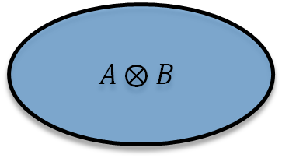
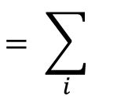




Tensors Operations
(1) Tensor product: Element-wise product of the values of each constituent tensor
$$A ⨂ B$$
${[A ⨂ B]}_{i_{1}{,… i}_{r},j_{1}…{ j}_{s}}$:= $A_{i_{1}, …i_{r}}∙B_{j_{1}, …j_{s}}$
$$A$$
$$B$$
$:$=
(2) Trace (partial): If $xth$ and $yth$ indices have identical dimensions ($d_{x}=$ $d_{y}=bond dimension) of tensor A;then,$
${[{Tr}_{x,y} A]}_{i_{1}{, …,i_{x−1},i_{x+1, …,}i_{y−1},i_{y+1, …,}i}_{r} }$:= $\sum_{α=1}^{d_{x}}{A_{i_{1}{, …,i_{x−1},{α,i}_{x+1, …,}i_{y−1},{α,i}_{y+1, …,}i}_{r}}}$
Bond
$$i$$
:=
$${Tr}_{Right}$$
$$= \sum_{i}{}$$
$$i$$

Slide 5





















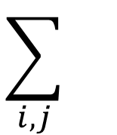



Tensors Operations
(3) Contraction: Tensor product followed by a trace between indices of two tensors.
Internal Indices: Bonds, here i and j
External Indices: free legs
$$i$$
$$i$$
$$\sum_{i,j}{}$$
:=
$$A$$
$$B$$
$$A$$
$$B$$
$$j$$
$$j$$
Examples:
Conventional
$\overset{→}{x}$ $. \overset{→}{y}$
$$\overset{→}{v}$$
$$M$$
$$AB$$
$$Tr(X)$$
Einstein
$$x_{α}y_{α}$$
$$M_{αβ}v_{β}$$
$$A_{αβ}B_{βγ}$$
$$X_{αα}$$
TNN
$$x$$
$$y$$
$$M$$
$$v$$
$$A$$
$$B$$
$$X$$
Inner Product
Matrix-vector multiplication
Matrix-matrix multiplication
Trace of a matrix

Slide 6



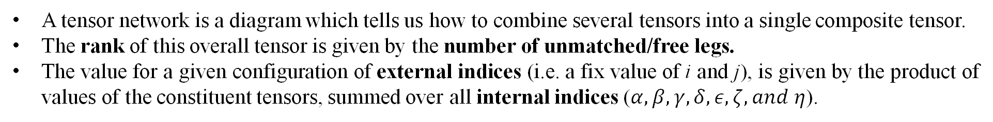


















Tensor Networks
A tensor network is a diagram which tells us how to combine several tensors into a single composite tensor.
The rank of this overall tensor is given by the number of unmatched/free legs.
The value for a given configuration of external indices (i.e. a fix value of i and j), is given by the product of values of the constituent tensors, summed over all internal indices ($α,β,γ,δ,ε,ζ, and η$).
$$i$$
$$j$$
$$i$$
$$j$$
$$γ$$
$$γ$$
$$∏$$
=
:=
$$\sum_{\begin{aligned}α,β,γ,δ, \\ ε,ζ,η\end{aligned}}{}$$
$$β$$
$$α$$
$$ε$$
$$where,$$
$$ε$$
$$ζ$$
$$η$$
$$β$$
$$δ$$
$$ζ$$
$$η$$
$$α$$
$$δ$$

Slide 7








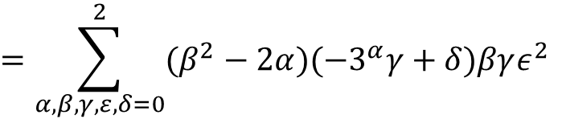

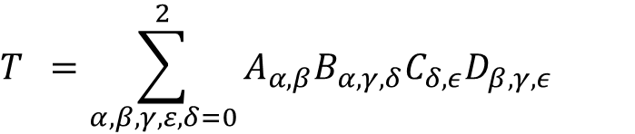












Tensor Networks
Example
$$A$$
$$β$$
$$β$$
$$D$$
$$=−3^{α}−2α$$
$$= β^{2}−2α$$
$$A$$
$$D$$
$$γ$$
$$α$$
$$ε$$
=
$$T$$
$$α$$
$$ε$$
$$γ$$
$$B$$
$$C$$
$$=−3^{α}−2α$$
$$= ε$$
$$B$$
$$δ$$
$$δ$$
$$C$$
$$T =\sum_{α,β,γ,ε,δ=0}^{2}{A_{α,β}B_{α,γ,δ}C_{δ,ε}D_{β,γ,ε}}$$
$$=\sum_{α,β,γ,ε,δ=0}^{2}{(β^{2}−2α)(−3^{α}γ+δ)βγε^{2}}$$
Internal Indices: All
External Indices: None
All indices are 3-dimentional
$$=1080$$

Slide 8



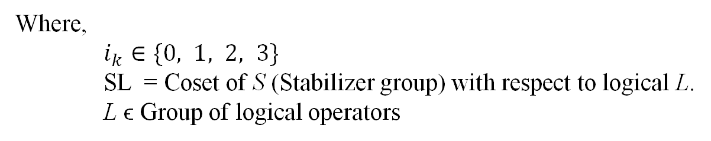





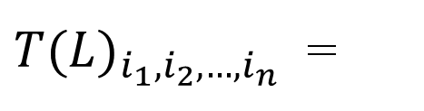

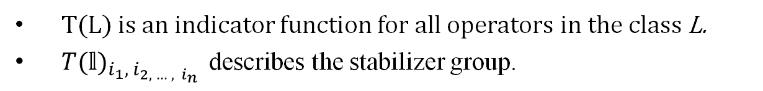
Stabilizer codes as Tensors
Represent Pauli operators by strings of integers.
$$I= σ^{0}, X= σ^{1}, Y= σ^{2}, Z= σ^{3}$$
$Ex. XZZXI= σ^{1}σ^{3}σ^{3}σ^{1}σ^{0} as the string (1, 3, 3, 1, 0)$
For a stabilizer code with n physical qubits, and k logical qubits, define the rank-n tensor for each logical operator L (ϵ Group of logical operators).
$$1 if σ^{i_{1}}⨂∙∙∙{⨂σ}^{i_{n}}∈SL$$
$$i_{1}$$
$$i_{2}$$
${T(L)}_{i_{1},i_{2},…,i_{n}}$ =
$$i_{n}$$
$$i_{3}$$
$$0 otherwise$$
$$T(L)$$
Where,
$i_{k}∈\{0, 1, 2, 3\}$
SL = Coset of S (Stabilizer group) with respect to logical L.
L ϵ Group of logical operators
$$i_{k}$$
Seed tensor
T(L) is an indicator function for all operators in the class L.
${T(𝕝)}_{i_{1},{ i}_{2, … ,{ i}_{n}}}$ describes the stabilizer group.

Slide 9

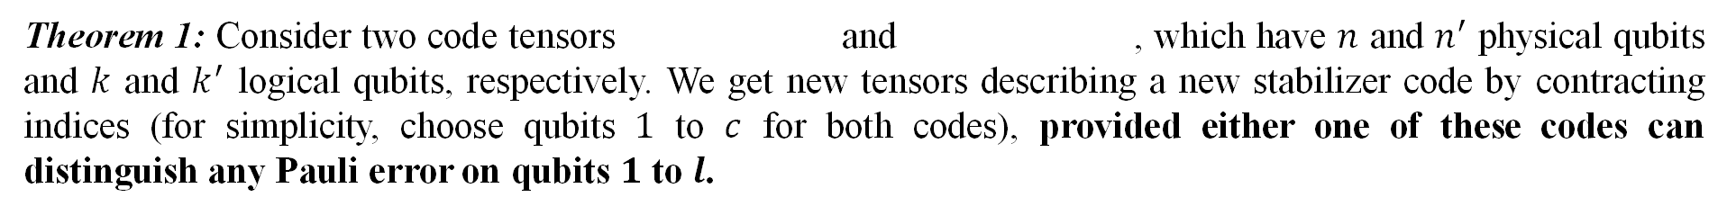
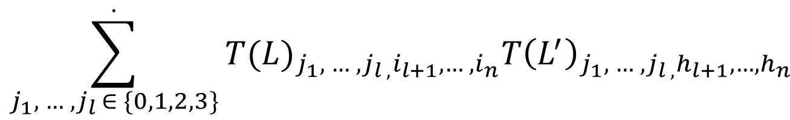
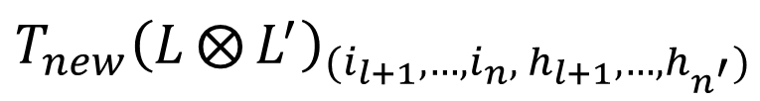


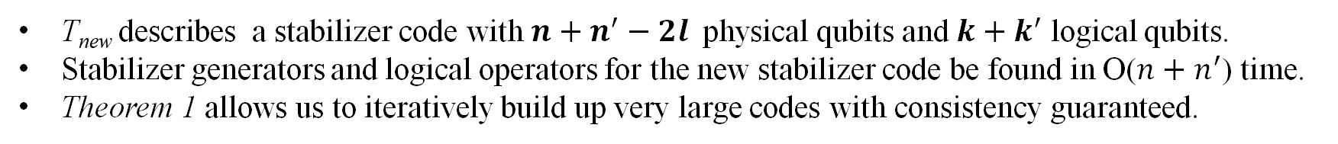
Generating new stabilizer codes
Contracting seed tensors generates larger codes.
But how to check if the newly formed code is also a stabilizer code?
Theorem 1: Consider two code tensors and , which have $n$ and $n^{′}$ physical qubits and $k$ and $k^{′}$ logical qubits, respectively. We get new tensors describing a new stabilizer code by contracting indices (for simplicity, choose qubits $1$ to $c$ for both codes), provided either one of these codes can distinguish any Pauli error on qubits $1$ to $l$.
${T(L)}_{i_{1},i_{2},…,i_{n}}$
${T\left(L^{′}\right)}_{h_{1},h_{2},…,h_{n}}$
${T_{new}\left(L⨂{L^{′}}\right)}_{(i_{l+1},…,i_{n},{ h}_{l+1},…,h_{n^{′}})}$
$$\sum_{j_{1},{ …, j}_{l }∈ \{0,1,2,3\}}^{.}{{T(L)}_{{j_{1},{ …, j}_{l ,}i}_{l+1},…, i_{n}}{T\left(L^{′}\right)}_{{j_{1},{ …, j}_{l ,}h}_{l+1},…,h_{n}}}$$
$$=$$
T_{new} describes a stabilizer code with $n+n^{′}−2l$physical qubits and $k+k^{′}$ logical qubits.
Stabilizer generators and logical operators for the new stabilizer code be found in O($n+n^{′}$) time.
Theorem 1 allows us to iteratively build up very large codes with consistency guaranteed.

Slide 10

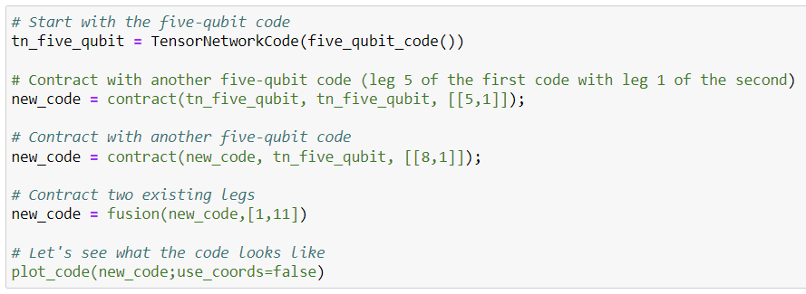

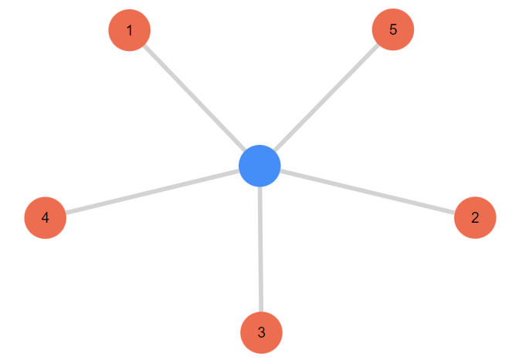
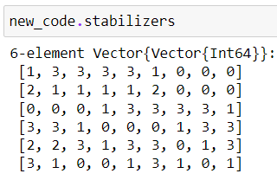
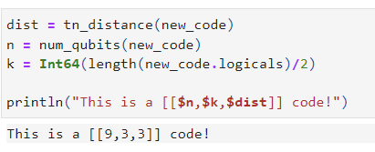
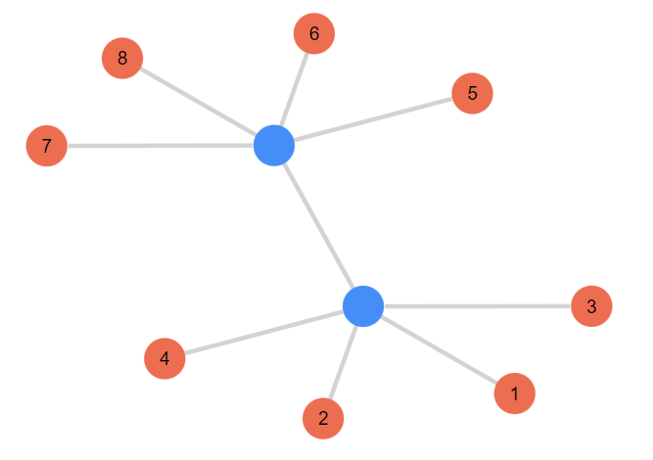
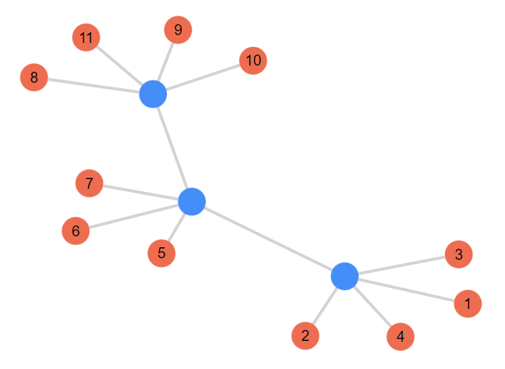
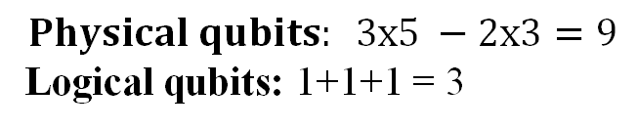
Generating new stabilizer codes
Example
Julia package:
https://github.com/qecsim/TensorNetworkCodes.jl
Distance calculation
[[5,1,3]]
[[9,3,3]]
$$Physical qubits: 3x5 −2x3=9$$
Logical qubits: 1+1+1 = 3
[[13,3]]
[[11,3]]
[[9,3]]
Iterations

Slide 11
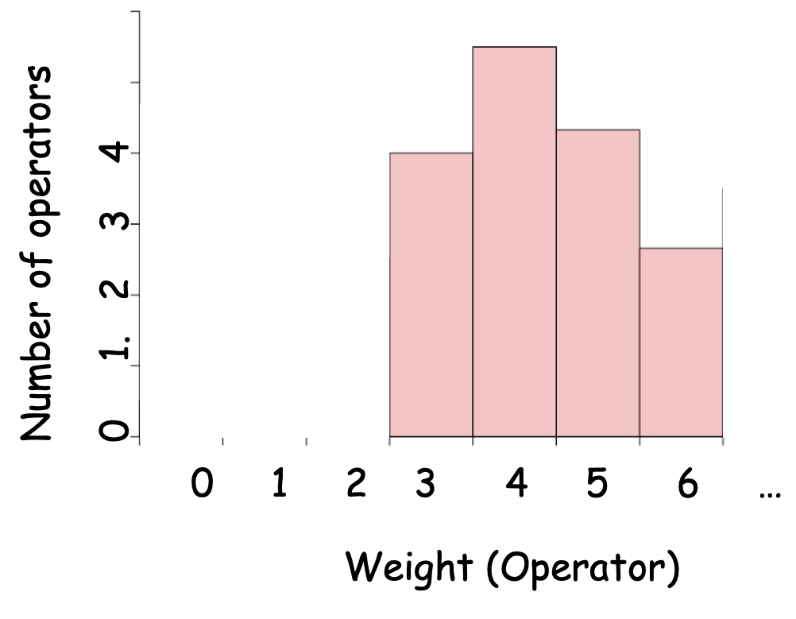
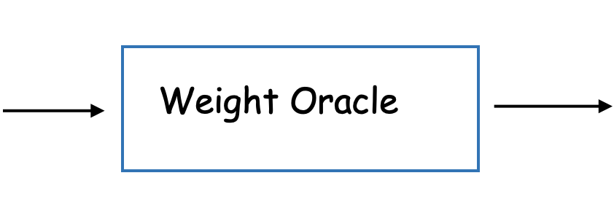
'Code Distance' via Tensor Network
Requirement for an efficient Weight estimator :
Existence of efficient contractable tensor structure in the input code.
In general, finding such structure is NP-Complete.

Slide 12
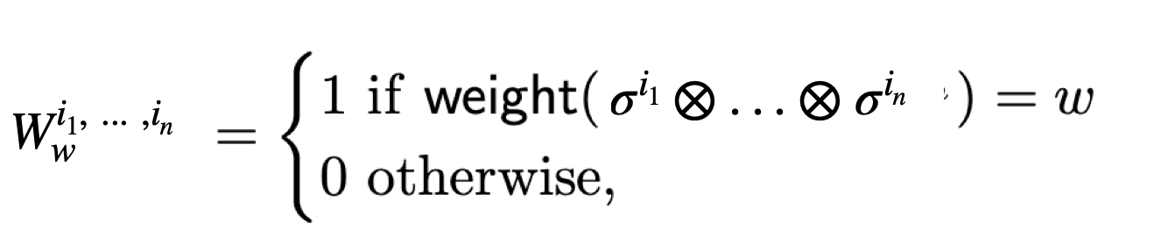
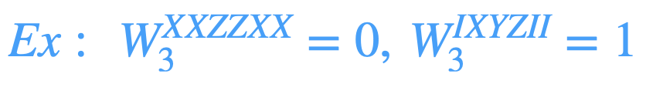
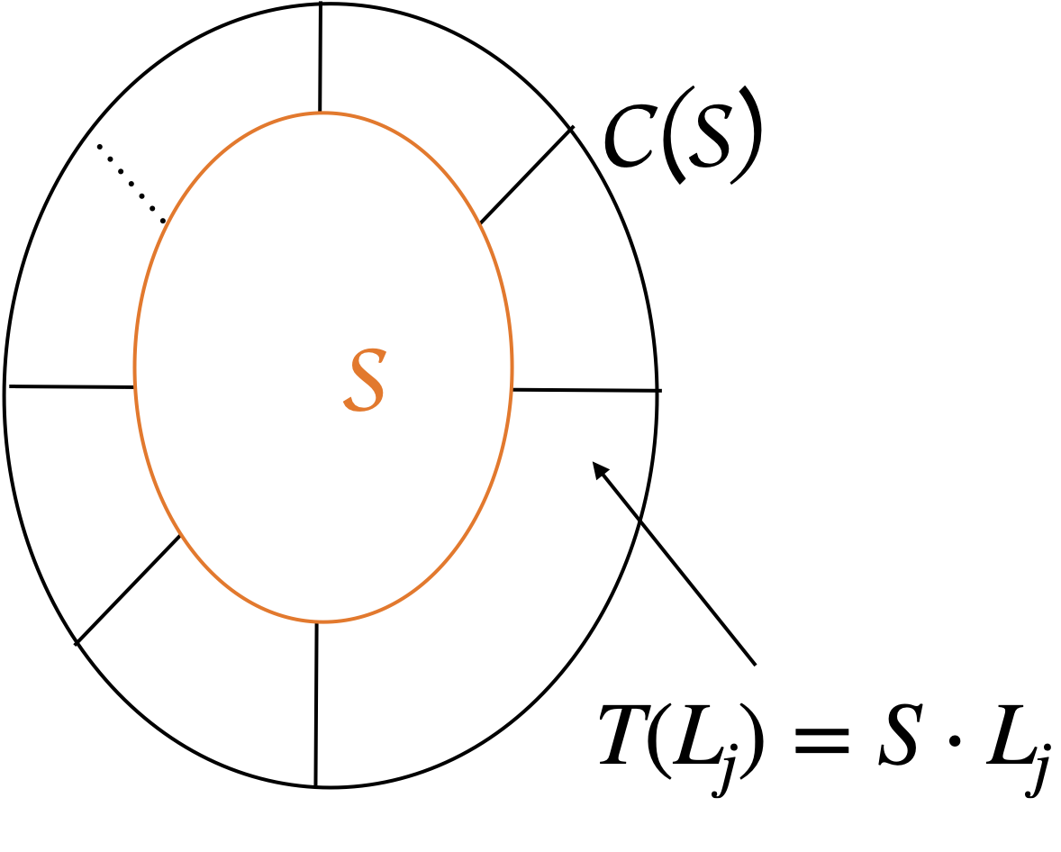
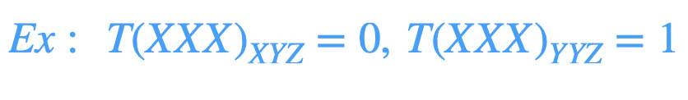
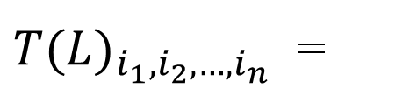


Construction of 'Weight-Oracle'
$$1 if σ^{i_{1}}⨂∙∙∙{⨂σ}^{i_{n}}∈SL$$
${T(L)}_{i_{1},i_{2},…,i_{n}}$ =
$$0 otherwise$$

Slide 13
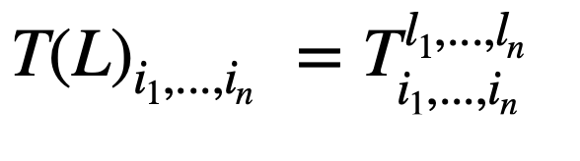
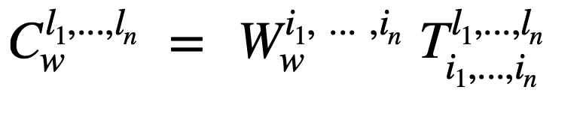
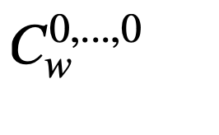
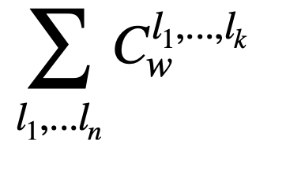

(Continue....)
[ Equivalent Representation)
= Number of stabilizer operator having 'w' weight.
= Number of Centraliser operator having 'w' weight.
= Number of C(S)/S
Operators having 'w' weight.

Slide 14
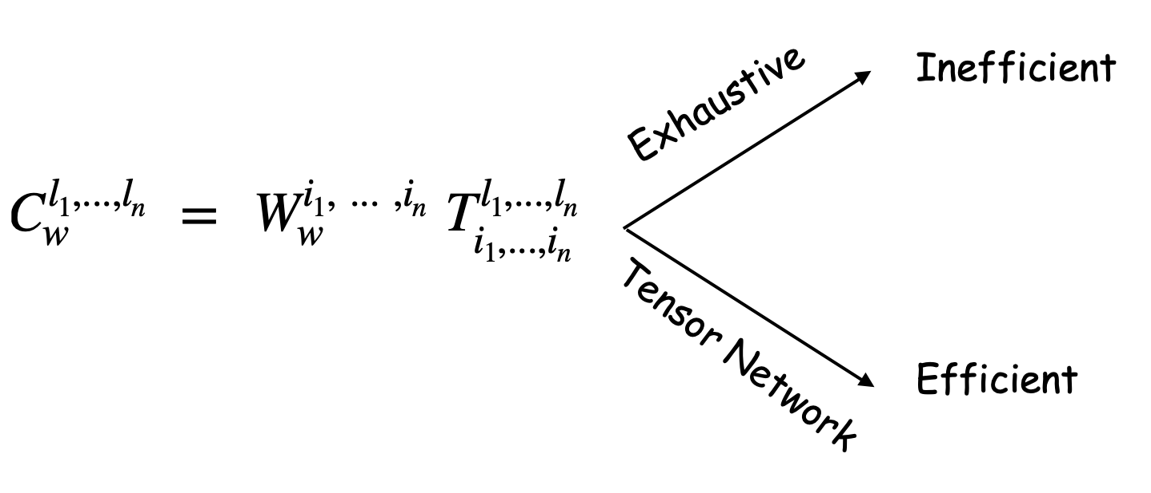
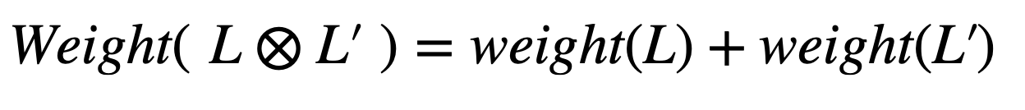
= Number of C(S)/S
Operators having 'w' weight.
Reason for Efficiency of TN strategy:

Slide 15
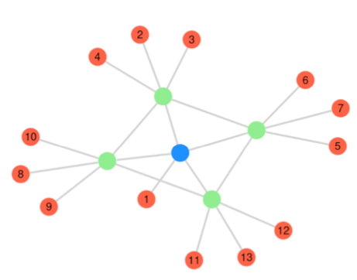
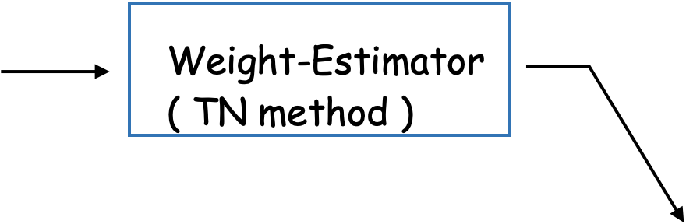
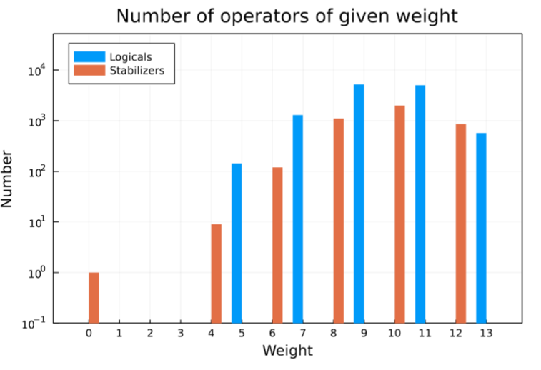
[[13, 1, 5]]
Other uses:
MERA Tensor network
Local ''Log-Depth'' Circuits
Holographic Codes

Slide 16
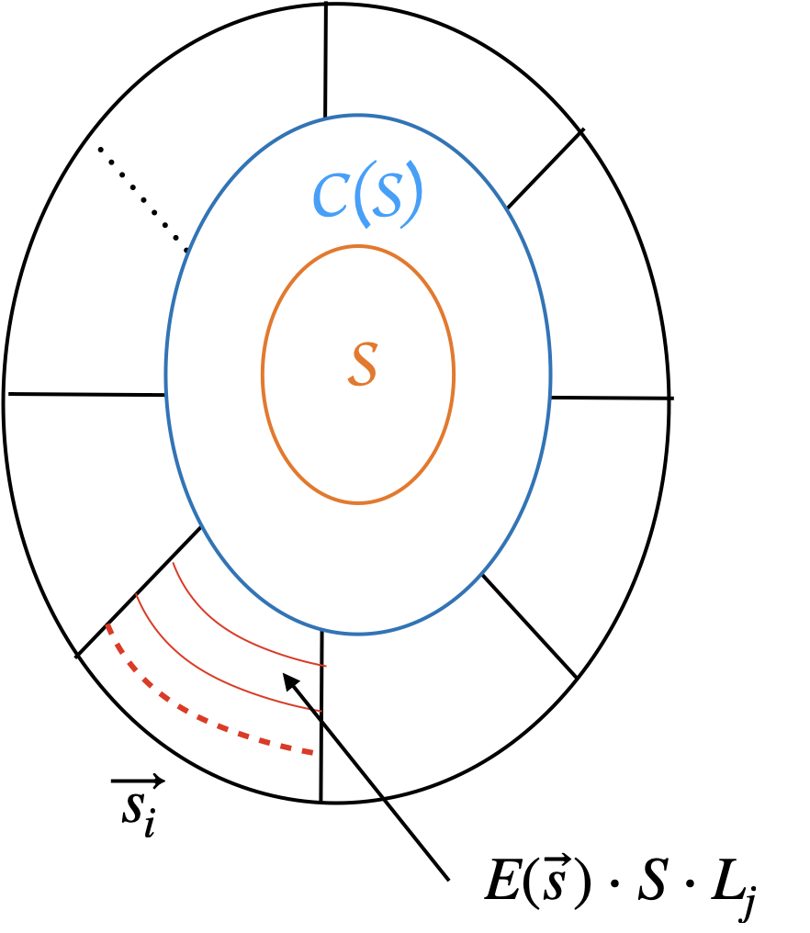
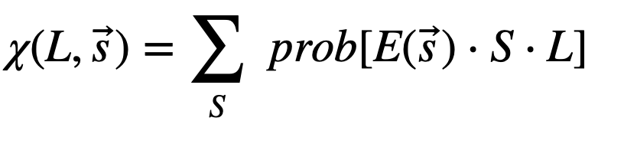
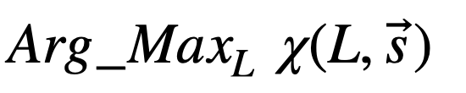

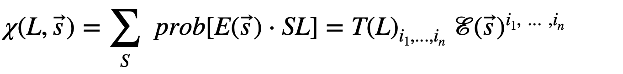
Maximum Likelihood Decoding (MLD): General Strategy
Start with Syndrome Measurement:
Goal:
In general, MLD computation is computationally hard problem (NP-complete).
(Recall) Toric code: MLD complexity
(Claim)

Slide 17
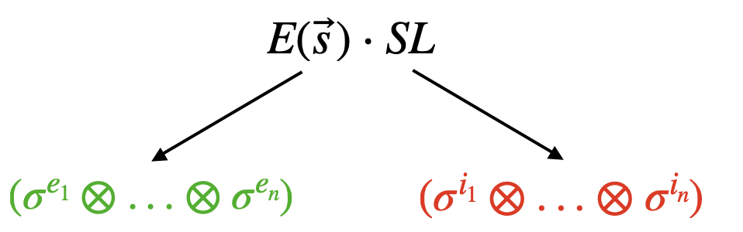
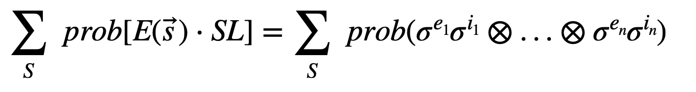
MLD via Tensor (continue...)
Tensor structure in:
Define,

Slide 18
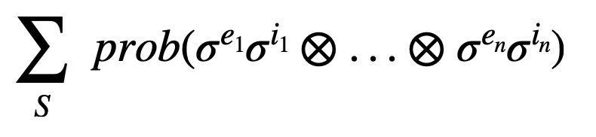
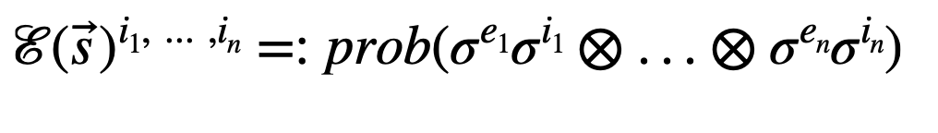


(Continue...)
Define,

Slide 19


(Continue...)
We have just found tensor structure in MLD estimation.
Efficient tensor contraction Efficient MLD estimation.
Simplification of the tensors under ''Uncorrelated Quantum channel'' assumption

Slide 20





Results
Codes | MLD (general) complexity | MLD (with TN) complexity | Assumptions
Planar Surface Codes |  |  | Uncorrelated Quantum channel, and a few more.
Holographic Codes (Ex. HaPPY code, 3-Qutrit, etc) |  |  | Uncorrelated Quantum channel and a few more.
Remarks:
Compare with MWPM via Edmond algorithms
Some more context of uses: MERA, Concatenated and Convolutional codes.

Slide 21
References
Farrelly, Terry, Tuckett, David K., and Thomas M. Stace. "Local tensor-network codes." ArXiv, (2021). Link
Bridgeman, Jacob C., and Christopher T. Chubb. "Hand-waving and Interpretive Dance: An Introductory Course on Tensor Networks." ArXiv, (2016). Link
Farrelly, Terry, Harris, Robert J., McMahon, Nathan A., and Thomas M. Stace. "Tensor-network codes." ArXiv, (2020). Link
https://github.com/qecsim/TensorNetworkCodes.jl
S. Bravyi, M. Suchara, and A. Vargo. Ecient algorithms for maximum likelihood decoding in the surface code. Phys. Rev. A, 90:032326, 2014. Link
Ferris, Andrew J., and David Poulin. "Tensor Networks and Quantum Error Correction." ArXiv, (2013). Link
https://errorcorrectionzoo.org/c/happy

Slide 22








$$A$$
$$H$$
$$K$$
$$N$$
$$T$$
$$U$$
$$Y$$
$$O$$

